Slide 1


Exam 70-535 Architecting Microsoft Azure Solutions Data & Cloud Skill Up Workshop - Azure Fundamentals
Welcome
To Burlington
WiFi: MSFTGUEST > Open Browser
Code: msevent795ny
For labs use:
-size “Standard_D1”
The Crew:
Speakers
Ryan Sockalosky, Dan Stolts, Patrick El-Azem, Coach Culbertson
Special Guests
Steve Ramsay, Ken Skvarcius, Dan Pessin
Design Compute Infrastructure (20-25%)
Design Data Implementation (15-20%)
Design Networking Implementation (15-20%)
Design Security and Identity Solutions (20-25%)
Design Solutions by using Platform Services (10-15%)
Design for Operations (10-15%)
Time | Topic | Speaker
8:30 | Breakfast, Registration, Setup
8:45 | Welcome | Ryan Sockalosky
9:00 | Agenda Overview | Dan Stolts
9:15 | Becoming a Cloud Architect & DevOps | Dan Stolts
9:50 | Fidelity Certified Services | Ryan Sockalosky
10:15 | Break & Networking with Microsoft
Slides: …/Presentations/2018-05-14-Boston/ Labs: …/Labs/
Content Home: http://github.com/guruskill/70-535
Program Home: https://aka.ms/certup
Laptop password: Password.1
Notes:
Presentation: 105 minutes
Lab: 50 minutes
After completing this module, students will be able to:
Identify suitable workloads for the cloud.
Identify services and capabilities that Microsoft Azure provides.
Use Azure portals to manage Azure services and subscriptions.
Use Windows PowerShell to manage Azure services and subscriptions.
Use Azure Command-Line Interface (CLI) to manage Azure services and subscriptions.
Describe the primary characteristics of Azure Resource Manager.
Use Azure services to enhance management and monitoring of Azure.
Required materials
To teach this module, you need the Microsoft PowerPoint file 20533D_01.pptx.
Preparation tasks
To prepare for this module, you should:
Read all this module’s materials.
Practice performing the demonstrations and labs.
Work through the Module Review and Takeaways section to determine how you will use the information to reinforce student learning and promote knowledge transfer to on-the-job performance.
As you prepare for this class, it is imperative that you complete the labs yourself. This gives you an understanding of how the labs work, as well as the concepts that each lab covers. This enables you to provide meaningful hints to students who might have issues while working in the labs. Furthermore, it will help guide your lecture to ensure that you discuss the concepts that the labs cover.
20533D
1: Introduction to Microsoft Azure

Slide 2
Agenda and Logistics 70-535 Architecting Azure Solutions
Room: 1st Floor – Washington/Jefferson
WiFi: MSFTGUEST; Open browser; Event Code: TBD
Content: https://github.com/guruskill/70-535 …
Folders Decks: Presentations\2018-05-14-Boston\ Labs: Labs\
Program Home: https://aka.ms/certup
Microsoft Office - 5 Wayside Rd, Burlington, MA
1st Floor – Washington/Jefferson
Day 1: Monday, May 14, 2018
Day 2: Tuesday, May 15, 2018
Time | Topic | Speaker
8:30 – 9:00 | Breakfast, registration, setup
8:45 – 9:00 | Welcome | Ryan Sockalosky
8:45 – 9:00 | Agenda Overview | Dan Stolts
9:15 – 10:15 | Becoming a Cloud Architect & DevOps | Dan
10:15 – 10:30 | Break & Networking with Microsoft
10:30 – 11:30 | Design Data Implementation | Patrick
11:30 – 12:30 | Design Network Implementation | Coach
12:30 – 1:30 | Lunch & Networking & Labs
1:30 – 2:45 | Design Compute Infrastructure | Dan
2:45 – 3:00 | Break & Networking with Microsoft
3:00 – 3:45 | Design Security & Identity Solutions | Coach
3:45 – 5:00 | Making it Real with Practical Application – Brainstorming & Labs | Dan, Coach, Patrick, Others
Time | Topic | Speaker
8:30 – 9:00 | Breakfast, registration, setup
9:00 – 10:15 | Exam Tips and Architecting for your company | Dan
10:15 – 10:30 | Break & Networking with Microsoft
10:30 – 12:00 | Design Solutions using Platform Services, Part 1 | Coach
12:00 – 1:00 | Lunch & Networking & Labs
1:00 – 2:00 | Design Solutions using Platform Services, Part 2 | Coach
2:00 – 3:15 | Design for Operations | Patrick
3:15 – 3:30 | Break
3:30 – 4:15 | Making it Real: Whiteboarding | All
4:15 – 4:45 | Making it Real: Architecting Real World Solutions – Whiteboarding | All
4:45-5:00 | Wrap-Up/Closing Next Steps and Homework (Labs)
Evaluation Link: https://tinyurl.com/510GA535

Slide 3
Show of Hands…
Who is taking a vacation, sick or personal day to be with us today?
Resist the urge to check email or do other non-class activities
Stay with us through the duration
Actively Participate
85% of attendees who take the exam pass it within 30 days
Notes:
Show of Hands…
Who is taking a vacation, sick or personal day to be with us today. As usual, either nobody is on vacation or nobody is actively participating ☺ I will assume the former.
What that tells me is your boss and your company want you to be here. They want you learn what we are teaching.
BUILD: So please, resist the urge to do email or other “stuff” while in class.
BUILD: Your mind is like a parachute, it only works if it is open and fully engaged. I know the mind wants to do more than what we are sometimes asking it to do in class. Stay focused so you get as much as possible out of the class. If you find your mind wandering…. Force it back into the game.
BUILD: Actively Participate and be fully engaged. When we are presenting, doing labs, demo’s, whiteboarding, Q & A or other activities, we need everyone to participate actively.
BUILD: If you do all of this you will be one of the 85% of the people that take this class and within 30 days get certified. More importantly, you will go back to work ready to Architect Azure Solutions.

Slide 4
Make the most of the event…
Think about how the technologies you learn about can be leveraged in your business!

Slide 5
Attendee Challenge – What Azure challenges should we tackle? What Challenges Are You Facing? What ideas do you have for projects?
Examples:
Contoso Purchases Fabrikam and needs to Migrate Fabrikam to Contoso or Azure
How to Architect Networks Using Isolation Security Zones to Enhance Security Posture When Moving to Azure
What challenges are YOU facing?
This is where you get the most out of this event!!!!
Parking Lot
Post It Notes

Slide 6
Making it REAL!!!
Making It REAL!!!
Day 1: Monday, May 14, 2018
Day 2: Tuesday, May 15, 2018
Time | Topic | Speaker
8:30 – 9:00 | Breakfast, Registration, Setup
8:45 – 9:00 | Welcome | Ryan Sockalosky
9:00 – 9:15 | Agenda Overview | Dan Stolts
9:15 – 9:50 | Becoming a Cloud Architect & DevOps | Dan Stolts
9:50-10:15 | Fidelity Certified Services | Ryan Sockalosky
10:15 – 10:30 | Break & Networking with Microsoft
10:30 – 11:30 | Design Network Implementation | Patrick El-Azem
11:30 – 12:30 | Design Data Implementation | Coach Culbertson
12:30 – 1:30 | Lunch & Networking & Labs
1:30 – 2:30 | Design for Operations | Patrick El-Azem
2:30 – 2:45 | Break & Networking with Microsoft
2:45 – 3:30 | Design Security & Identity Solutions | Coach Culbertson
3:30 – 5:00 | Making it Real with Practical Application – Brainstorming & Assigned Labs | Dan, Coach, Patrick, Others
Time | Topic | Speaker
8:30 – 9:00 | Breakfast, Registration, Setup
9:00 – 10:15 | Exam Tips and Architecting for Your Company | Dan Stolts
10:15 – 10:30 | Break & Networking with Microsoft
10:30 – 12:00 | Design Compute Infrastructure | Dan Stolts
12:00 – 1:00 | Lunch & Networking & Labs
1:00 – 3:15 | Design Solutions Using Platform Services | Coach Culbertson
3:15 – 3:30 | Break
3:30 – 4:15 | Making it Real: Whiteboarding | Dan, Coach, Others
4:15 – 4:45 | Making it Real: Architecting Real World Solutions – Whiteboarding | Dan, Coach, Others
4:45-5:00 | Wrap-Up/Closing Next Steps and Homework (Labs) | Dan, Coach
Room: 1st Floor - Washington
WiFi: MSFTGUEST; Open browser; Event Code: TBD
Content: https://github.com/guruskill/70-535 …
Folders Decks: Presentations\2018-05-14-Boston\ Labs: Labs\
Evaluation Link: https://tinyurl.com/510GA535

Slide 7
We have exam vouchers!!!
50% off for next 30 days
Please take the exam within the voucher activation window.
The voucher is tied directly to you and will be emailed directly to you right after the event.

Slide 8
We have free practice exams
Free Test Prep Voucher:
We are offering a test prep voucher to every attendee on a request basis only. Attendees will have to email skillupmsft@microsoft.com to receive their code after the event. They will receive a note about this in their Thank You email but please make sure this is something you promote at this event. Please note: There is a limited number of vouchers available. They are distributed on a first-come, first-served basis until all our vouchers have been requested.

Slide 9
Program Roadmap - So Far…Futures coming later
Certification Training (85% Pass Rate)
70-533 Implementing Azure Solutions
70-535 Architecting Azure Solutions
70-475 Big Data
70-774 Machine Learning
70-777 Cosmos DB
Linux on Azure (with Linux Foundation) Kicks off June 2018
Pilot Deep Dives
DevOps
Many Projects, many customers
Program Home: https://aka.ms/certup

Slide 10
Getting Started Labs https://docs.microsoft.com/en-us/azure/#get-started
Deploy infrastructure
Linux virtual machines
Windows virtual machines
Secure and manage resources
Azure Security Center
Azure Monitor
Azure Application Insights
Azure Cost Management
Azure Backup
Azure Site Recovery
Azure Migrate
Azure Policy
Develop apps
Manage data and AI
Relational Databases
SQL database as a service
SQL Data Warehouse as a service
PostgreSQL database as a service
MySQL database as a service
NoSQL
Azure Cosmos DB
Storage
Blob Storage
AI and Cognitive Services
Machine Learning
Cognitive Services
.NET Python Java | PHP Node.js Go
App Models
Web Apps
Serverless Functions
Containers
Microservices with Service Fabric
https://docs.microsoft.com/en-us/azure/#get-started

Slide 11
Labs
http://github.com/guruskill/70-535 Labs folder

Slide 12
Make the most of the event…
Think about how the technologies you learn about can be leveraged in your business!

Slide 13
Voting: Show of Hands
How deep is your knowledge of Azure Cloud Solutions?
1. I know Azure and its offerings really well
2. I have a good base knowledge of Azure
3. I know some of Azure
4. I’m just getting started with Azure

Slide 14
Voting: Show of Hands
Are you planning on taking the Azure Certification Exam related to this content?
1. Yes
2. Maybe, I’m interested in finding out more
3. No

Slide 15
Voting: Show of Hands
Do you feel you are educationally ready to deliver Azure Solutions Now?
1. Yes, Ready to go
2. Maybe, after doing homework, I will be ready
3. No

Slide 16
Buckle Up!!!
Early morning sessions are foundational
Everything else we dive deep into AZURE!

Slide 17
Following slides are NOT for the morning. They are Making it real
Do not present the following slides in the opening. They are for later in the event.

Slide 18
Good Afternoon!!!! Pause for program identification
Room: 1st Floor – Washington/Jefferson
WiFi: MSFTGUEST; Open browser; Event Code: TBD
Content: https://github.com/guruskill/70-535 …
Folders Decks: Presentations\2018-05-14\ Labs: Labs\
Program Home: https://aka.ms/certup
Microsoft Office - 5 Wayside Rd, Burlington, MA
1st Floor – Washington/Jefferson
Day 1: Monday, May 14, 2018
Day 2: Tuesday, May 15, 2018
Time | Topic | Speaker
8:30 – 9:00 | Breakfast, registration, setup
8:45 – 9:00 | Welcome | Ryan Sockalosky
8:45 – 9:00 | Agenda Overview | Dan Stolts
9:15 – 10:15 | Becoming a Cloud Architect & DevOps | Dan
10:15 – 10:30 | Break & Networking with Microsoft
10:30 – 11:30 | Design Data Implementation | Patrick
11:30 – 12:30 | Design Network Implementation | Coach
12:30 – 1:30 | Lunch & Networking & Labs
1:30 – 2:45 | Design Compute Infrastructure | Dan
2:45 – 3:00 | Break & Networking with Microsoft
3:00 – 3:45 | Design Security & Identity Solutions | Coach
3:45 – 5:00 | Making it Real with Practical Application – Brainstorming & Labs | Dan, Coach, Patrick, Others
Time | Topic | Speaker
8:30 – 9:00 | Breakfast, registration, setup
9:00 – 10:15 | Exam Tips and Architecting for your company | Dan
10:15 – 10:30 | Break & Networking with Microsoft
10:30 – 12:00 | Design Solutions using Platform Services, Part 1 | Coach
12:00 – 1:00 | Lunch & Networking & Labs
1:00 – 2:00 | Design Solutions using Platform Services, Part 2 | Coach
2:00 – 3:15 | Design for Operations | Patrick
3:15 – 3:30 | Break
3:30 – 4:15 | Making it Real: Whiteboarding | All
4:15 – 4:45 | Making it Real: Architecting Real World Solutions – Whiteboarding | All
4:45-5:00 | Wrap-Up/Closing Next Steps and Homework (Labs)
Evaluation Link: https://tinyurl.com/510GA535

Slide 19
Program Roadmap
So Far…
Next Fiscal Year Starting July 2018
Certification Training (85% Pass Rate)
70-533 Implementing Azure Solutions
70-535 Architecting Azure Solutions
70-475 Big Data
70-774 Machine Learning
70-777 Cosmos DB
Linux on Azure (with Linux Foundation) Kicks off June 2018
Pilot Deep Dives
DevOps
Many Projects, many customers
Certification Training
70-458 DevOps on Azure
70-532 Developing Azure Solutions
Create Deep Learning path for all technologies

Slide 20
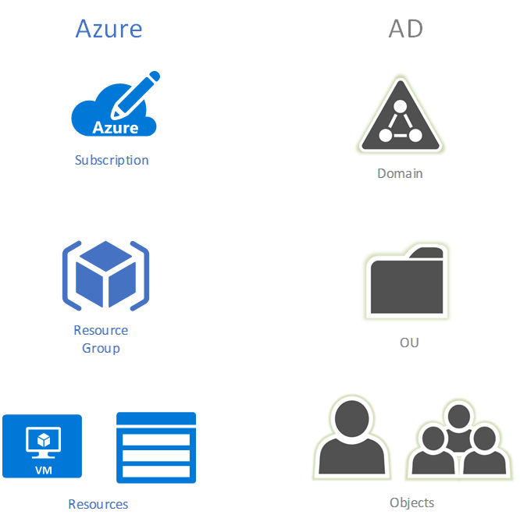
Hierarchy
Account
Subscription 1
AD
Resource Group RG1
RG2
AAD
RG3..n
No Nesting
Entities/Users
B2B
Roles
Subscription “n”
(Tenent x)
B2C
Parent
Child
1:n
RGx
Resources…
WebApp
Vm…
vNet…
Etc..
Policy
Eg. No Access RG3
Notes:
AD/RG Image: https://blogs.technet.microsoft.com/dsilva/2017/11/10/azure-subscription-governance-resource-group-and-naming-convention-strategies/

Slide 21
Parking Lot Speaker Panel
User Experience Latency
Ingress and egress (latency and cost)
Hybrid Workloads
Automated Testing
Containers
Securing IaaS
Network Routing and Traffic Manager
SaaS Costs and Elastic Limits
Service Limits and Quota’s
Azure Batch? More info needed
Moving real workloads to Azure (IIS, ASP, Java, Database)
Web App: turn off anonymous access at root url but allow at virtual app level

Slide 22
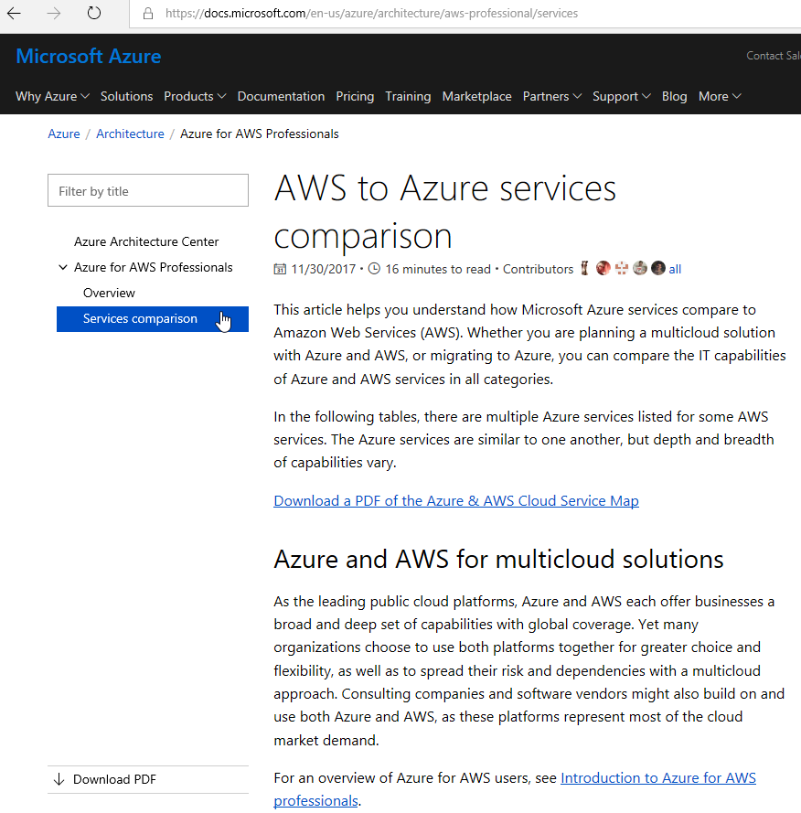
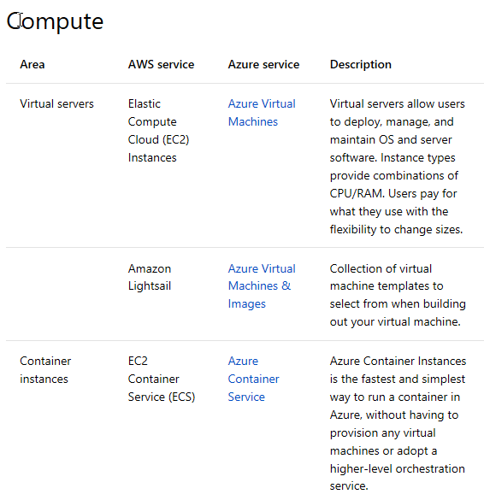
AWS to Azure Services Comparison
https://docs.microsoft.com/en-us/azure/architecture/aws-professional/services

Slide 23
Azure Capacity Planning

Slide 24

Good to know
Azure DOES have limits!! Per Azure Sub and even per Azure Region
Know the Service-specific quota limits - Limits
Some limits are a hard maximum, while others are a soft limit that can be increases upon request.
Involve your Microsoft Architects in planning…. EARLY!!!
You can increase quota!
“But I Thought Azure had Infinite Capacity?”
Limits are Good….Kinda
Limits help keep you cloud spending predictable by not allowing you to spin up the resources that could generate a huge monthly bill without you doing it on purpose. This save you and Microsoft money since they’d likely need to refund lots of cloud spending if all customers were allowed to go unchecked.
Limits help Microsoft throttle the growth of cloud usage; both within individual Azure Regions, as well as Globally across all their datacenter and regions. This allows Microsoft to ensure that individual customers aren’t able to overload any particular Azure Region or data center unexpectedly.
Be an Architect 535 Exam
January 2017

Slide 27

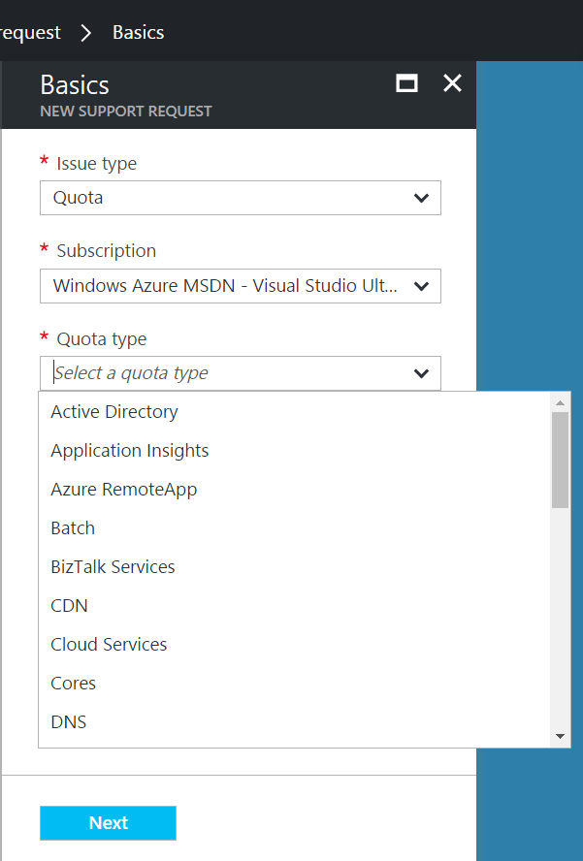
Good to know
Very large quota requests may take more than a day to be processed
Depending on how many cores are requested, a simple credit check initiated by the Support Team may be required
Recommended approach
Step 1: Visit the Azure Portal and click on ‘Help + Support’ and open a new support request.
Step 2: Click ‘Quotas’ under Issue Type and select the type of subscription for which you want to change the quota.
Step 3: Choose the resource type where you want to increase the quota.
Example 1: Increase number of cores
Example 2: Increase Storage
Step 4: Enter your preferred contact method and contact information and create the support case
“How do I increase Azure Quota?”
Support Type: Free Assisted - Billing
January 2017

Slide 28
Post Event Wrap/Up

Slide 29
Time For Feedback!

Slide 30
Show of Hands
Who feels like the knowledge you obtained in this class will help your company?

Slide 31
Show of Hands
Who feels like the knowledge you obtained in this class will help your career?

Slide 32
Do you want more free training for you, your friends and peers?
Feedback is very, very important to Microsoft. It is the mechanism we use to get additional funding to have more workshops.
Please help us help you & your peers, now and in the future. Give us the evidence that this is a worthwhile investment.
It only takes a couple minutes to fill out the survey at the end of the class. Even if you miss some of the class, it is very important that we get your feedback!
THANK YOU! From our entire training team!!!

Slide 33
Live Feedback: In your own words: What did you think of …
Please provide:
Contact First+Last Initial:
Company [optional]:
Event
Content
Speakers
Topics
Event Flow
Azure Capabilities
Training Leading to Cert
Workshop Model/Flow
Specific Azure Service
Value to You personally
Value to your company
Other

Slide 34
Feedback: Making the Most of the event Your Projects
What types of project(s) do you have or hope to drive where Azure may provide a solution?
Open Discussion
Project:
Contact First+Last Initial:
Company [optional]:
Can you benefit from help from Microsoft:

Slide 35
What can we do better?
Please email dstolts@microsoft.com

Slide 36
Evaluation Form Super Important. Please invest another 2 minutes now to fill out the event survey.
URL: https://tinyurl.com/514MA18

